Slide 1
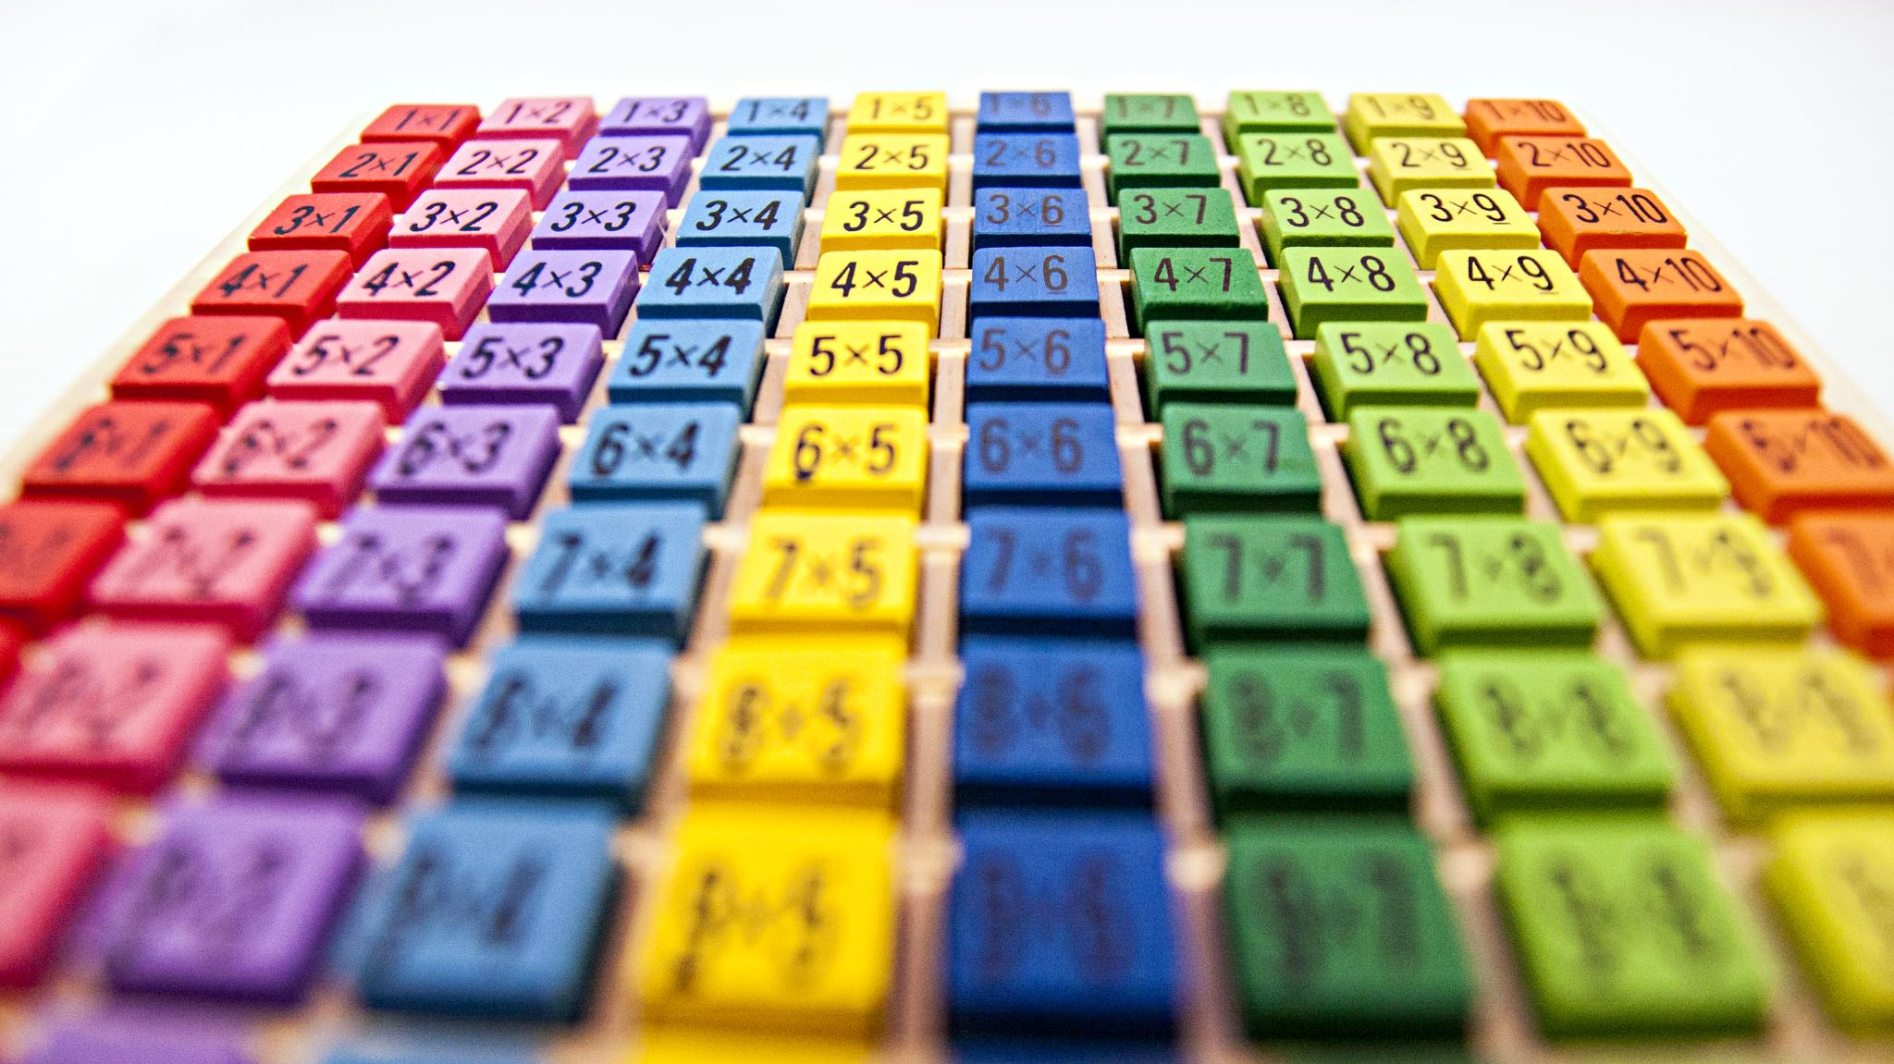
Classification using YOLOv8 On Logo2k
By Mohith Reddy Sangavaram

Slide 2
Dataset
Applied classification on YOLOv8 electronics dataset from Logo2k(https://github.com/Wangjing1551/Logo-2k-plus-Dataset/tree/master)
Electronics has 191 classes with 13972 images

Slide 3
Model
Used YOLOv8 classification model from Ultralytics (https://docs.ultralytics.com/tasks/classify/)
YOLOv8 is a powerful, efficient, and versatile deep learning model used for object detection and classification.
YOLOv9 does not have classification so I went with YOLOv8 as it gives better results.

Slide 4
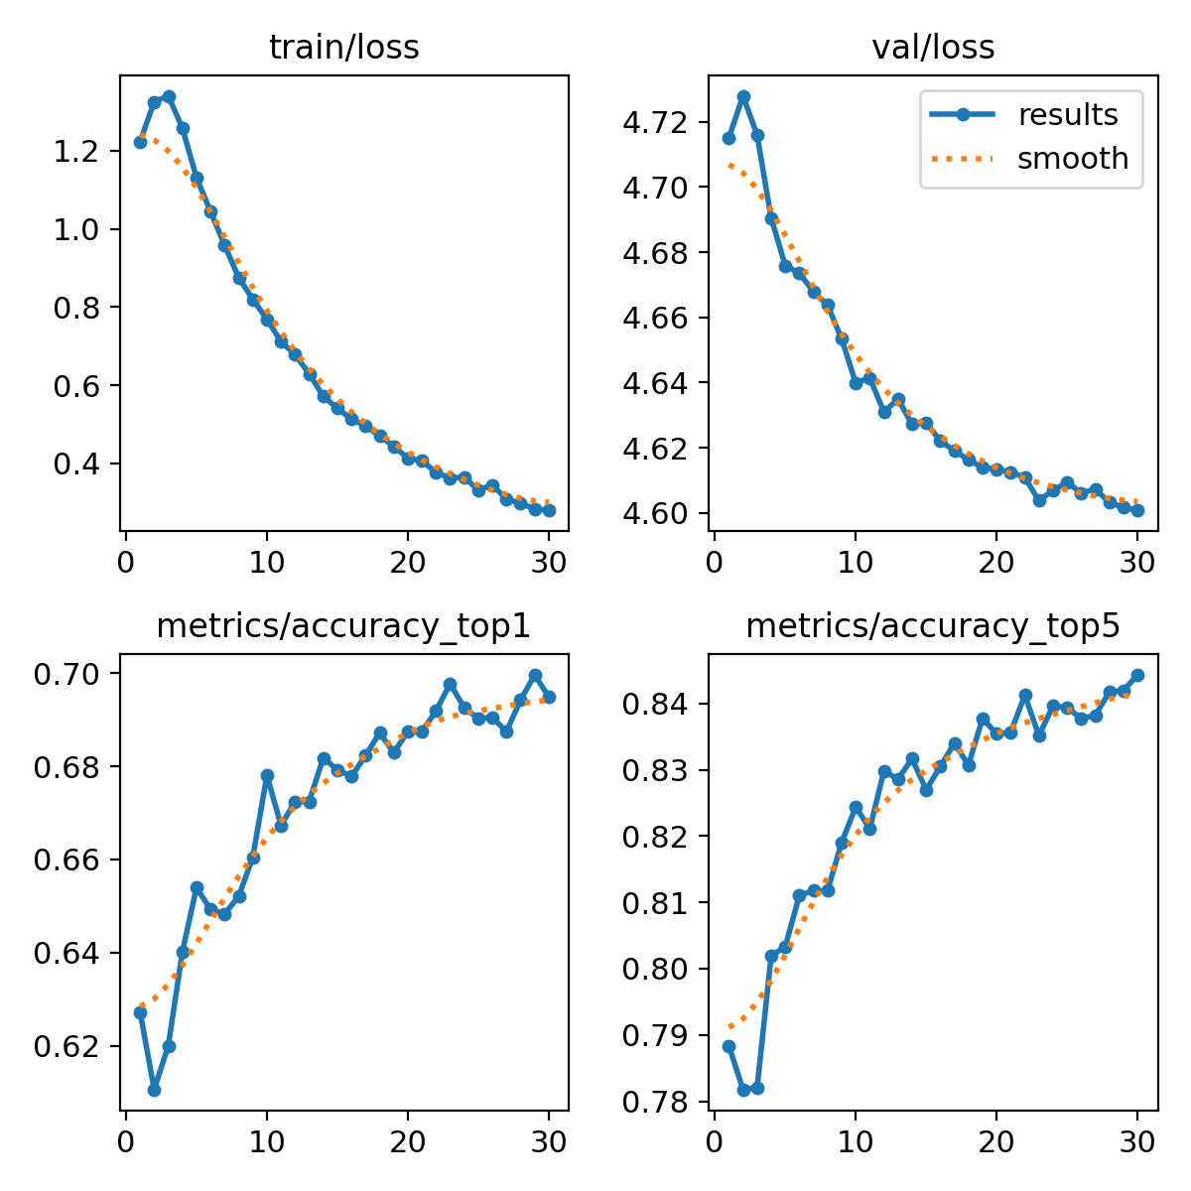
Method applied
config_file = os.path.join(os.getcwd())
results = model.train(data = config_file, epochs=30,imgsz = 256)
The training runs for 30 epochs, and the images are resized to 256x256 pixels (imgsz=256) for training.

Slide 5
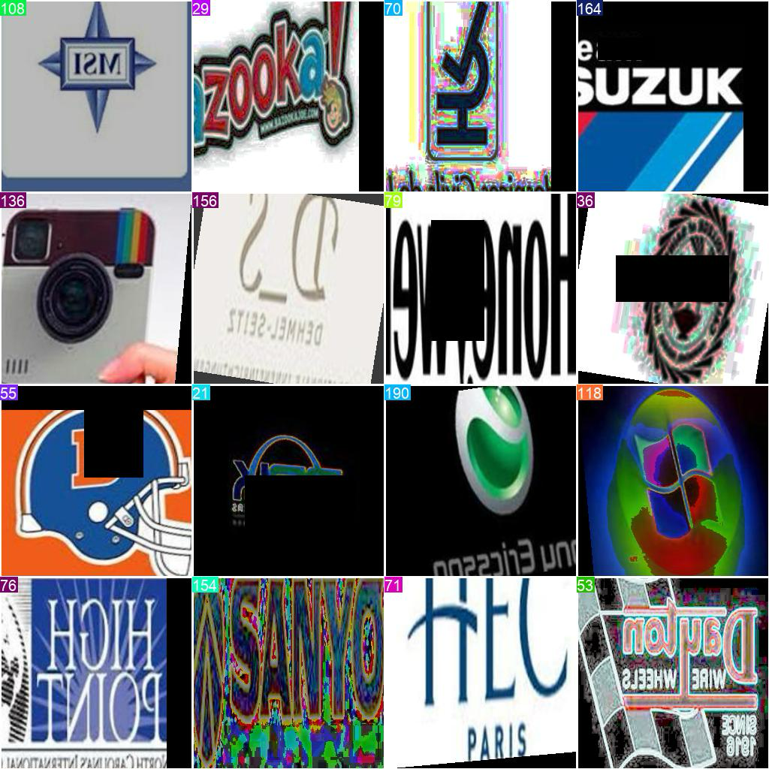
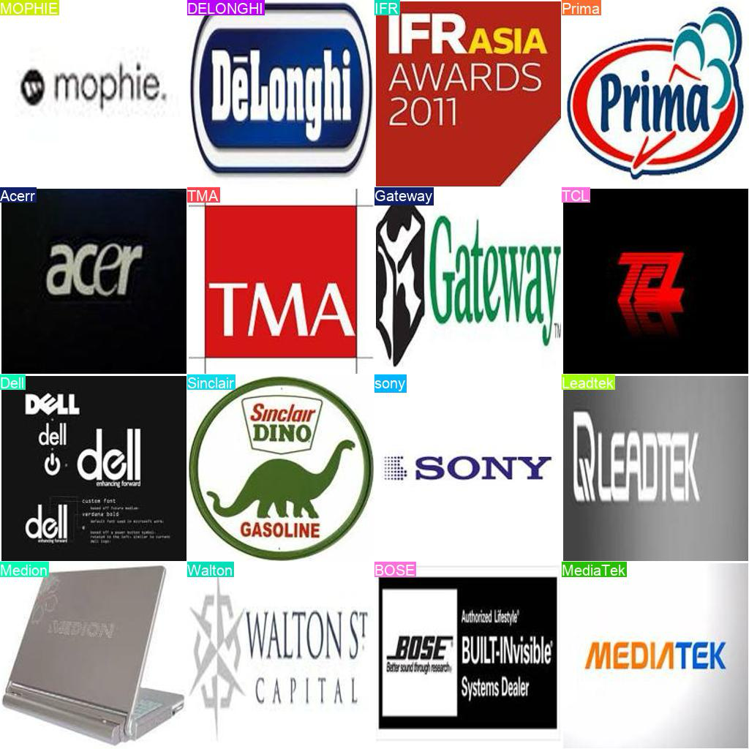
Train and Validation batch:

Slide 6
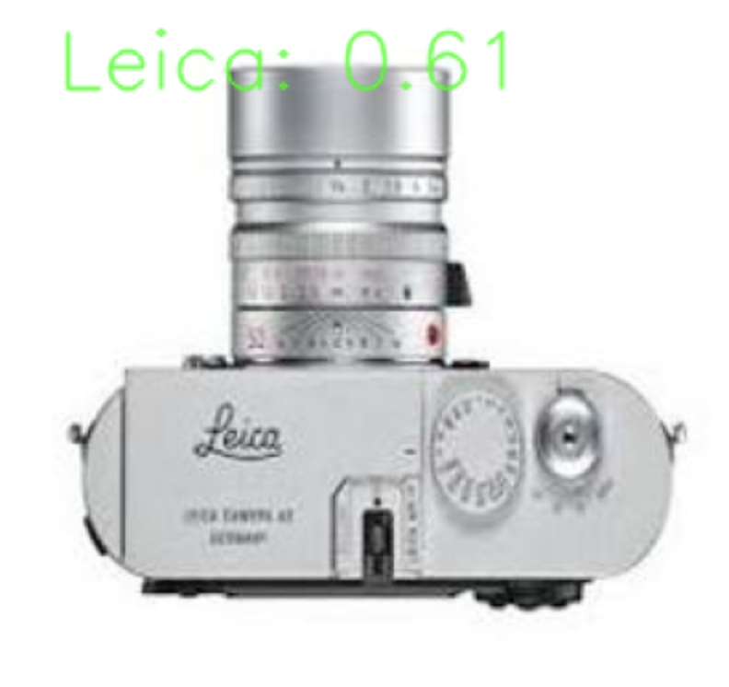

Results

Slide 7
Limitations
Due to hardware limitations I used only part of Logo-2k-plus data set.
Since YOLOv9 we have to label the data and later train the model to classification I decided to use v8 for classifications.
Had to run up to 30 epochs.

Slide 8
Resources
YOLOv8. https://docs.ultralytics.com/tasks/classify/
Siddheshwar Harkal. Image Classification with YOLOv8. https://sidharkal.medium.com/image-classification-with-yolov8-40a14fe8e4bc

Slide 9
Appendix
Python 3.11.7
Ultralytics
OpenCV
Numpy
Matplotlib
Electronics from Logo-2k-plus

Slide 10
Thank you

